Slide 1
Project Report
चूक ना जाना
“Delishably”
का खाना
TEAM 15

Slide 2
Team Members
Akansh Vaibhav - S20210010010
Anmol Kumar Pandey - S20210010022
Akash Singh Narvariya - S20210010012
Dhruv Raj - S20210010066
Rohan Kumar - S20210010194

Slide 3
Table of contents
01
02
03
04
Abstract
UML/ER Model
Working
Result

Slide 4
1
Abstract
Brief Overview of the Project

Slide 5
Project Summary
The aim of the Restaurant Chain Management System is to create an admin application that can be used by the Restaurant Owner and Workers which helps to improve their efficiency and to maximize the profit margin of restaurant owners by providing them better service which includes data visualization as well. The system caters to three types of users within an organization namely:
Restaurant Chain Owner
Branch Manager
Regular Employee
Each of them has different access permissions and different features to work with.
This project is GUI based and uses MySQL as its Database System to manage all the humongous data. It uses JDBC Library to connect the Database and Java code. The GUI and data visualization in the project is made by JavaFX.

Slide 6
2
UML/ER Model
Visual Representation of Classes and MySQL Tables

Slide 7
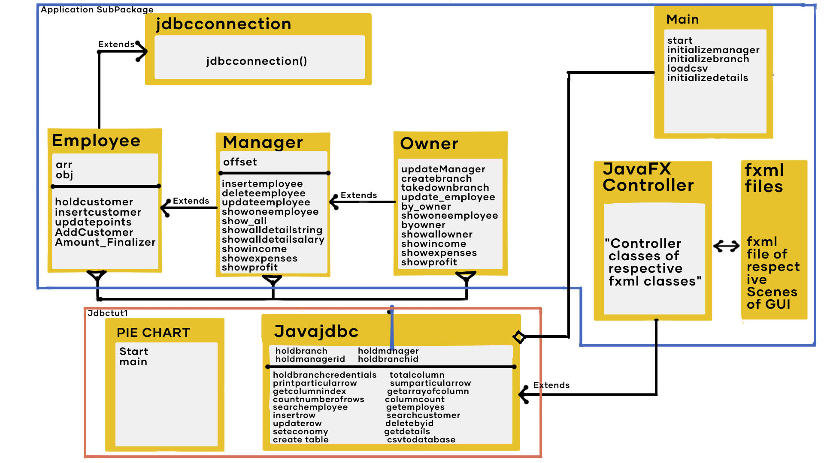
UML Diagram

Slide 8
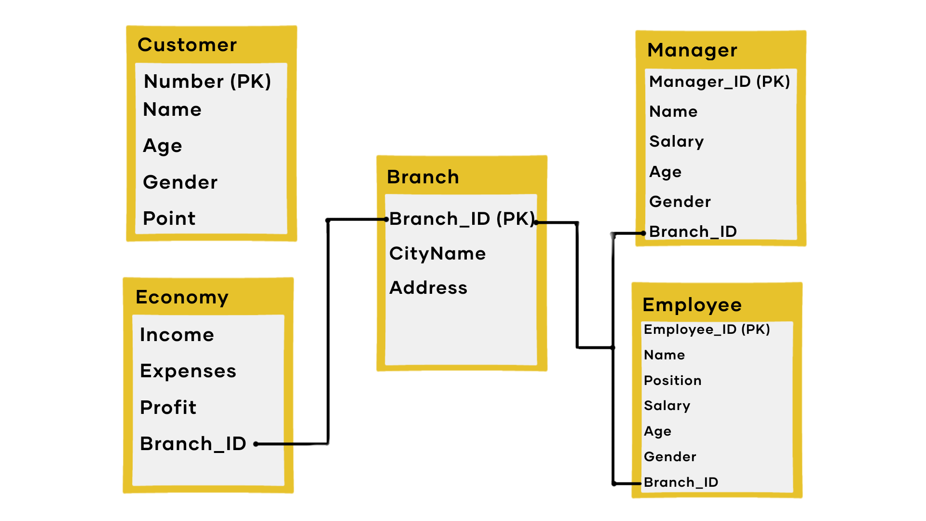
ER Diagram

Slide 9
3
Working
Detailed Working of the Project

Slide 10
Main Class
The Main class calls the JavaFX code to present the starting the interface of the application, which gives the option to login based on different Username and Password.
After entering as one the given above the user can perform their respective functions which are given to them.
There are three types of Entry Options :
Employee
Manager
Owner

Slide 11
Employee Functions
After entering into Employee interface the Employee has option to take order of the Customer.
After selecting that the menu is popped in front of Employee from which he can select order of his customer and view the order.
After confirming the order, the Employee has to enter the details of the Customer.
Based on the details if the customer is a previous Customer then he will get discount based on points gained from last order( 20 % of last order).
If the Customer is a new Customer then he will be added to the list and his points based on current order will be added to Customer table.
These Methods are provided by Employee Class which extends JDBC Connection Abstract Class (For JDBC Connection). The Employee Class is further Extended by the Controller classes of the Respective JavaFX Code.

Slide 12
Manager Functions
After entering the Manager Interface the user has two major Actions to Perform :
Manage Employee
After choosing this option the user can Add, Delete, Update or View Employee Details.
The Application takes in the Employee details and Adds, Delete or Updates it based on the Function.
For Viewing Employee there are 4 Methods :
First being view details of one employee based on Employee_ID.
Second option is to view all Employee details with paging of 5 Employees at one time.
Third option is to See details of all Employee based on Name or Partial Name.
Third option is to view details of all employee with a salary greater than any value.
Manage Economy
This provides the Manager the option to view the Income, Expenses and Profit of the store to which Manager belongs.
These Methods are provided by Manager Class which extends Employee Class. The Manager Class is further Extended by the Controller classes of the Respective JavaFX Code.

Slide 13
Owner Functions
After entering the Owner Interface the User has 4 major options:
Manager Branch
The user can Create a new Branch (By entering the details) and assign a new Manager to it (By entering the details of a new Manager).
Or the user can Take down a existing Branch deleting all it details including Manager and Employees as well
Manage Manager
This option allows the user to Edit the details of the existing Manager in the database based on their unique ID
Manage Economy
This option allows the user to view the Income, Expenses and Profit of the whole Restaurant.
Data Visualization
This options gives
These Methods are provided by Owner Class which extends Manager Class. The Owner Class is further Extended by the Controller classes of the Respective JavaFX Code. The Data Visualization is provided by ___ class using JavaFX.

Slide 14
Javajdbc Class
Javajdbc class is used to establish Connection between java and MySQL.
It has Public variables that holds the value of all Manager ID and all Branch ID, which updates itself if a new entry is added.
It has methods to execute the MySql queries as well.
These methods are :
Holdbranchdetails alltablevaluesQuery getConnection printparticularcolumn Particularcolumntoarray searchemployee
Insertrow searchcustomerdetails Updaterow
seteconomy getdetails createtable
csvtodatabase Insertcustomerdetails deleterow_by_id
get_employees_with_same_category a_particular_rowtoarray
Count_number_of_rows columncount
get_particular_row_number_basedon_id get_a_fresh_statement
totalcolumnscountQuery printparticularrow
sumparticularrow get_column_index get_arrayof_column_names

Slide 15
JavaFX and GUI Brief
JavaFx is used to provide the GUI in the whole application.
The fxml files were created with the help of the Scene Builder and they were made responsive by the Controller class of the Java.
Majority of these controller classes extend the Javajdbc method and some extend Employee, Manager and Owner classes
These controller classes takes the inputs from the user in the GUI. Then they call methods from respective classes and pass the required value in them so that they perform their function.

Slide 16
4
Result
Output of Project

Slide 17
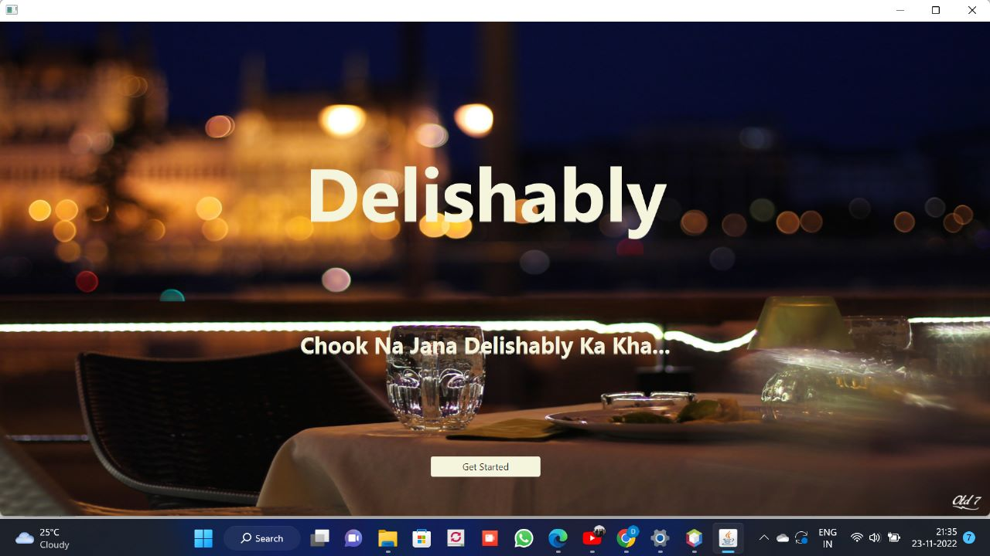
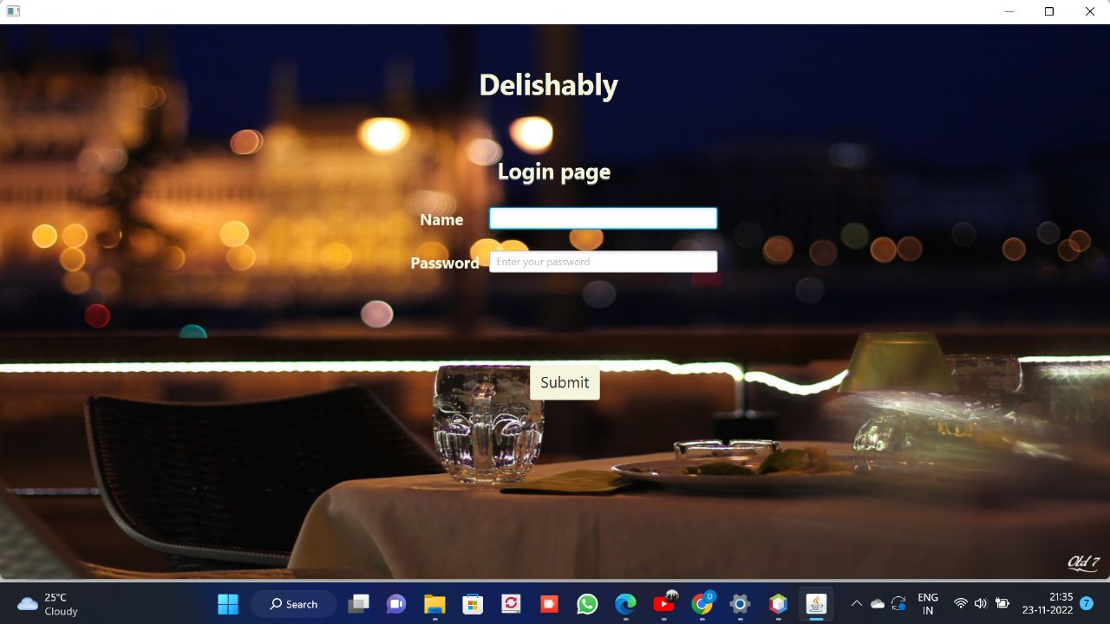
Entry and Login Screen

Slide 18
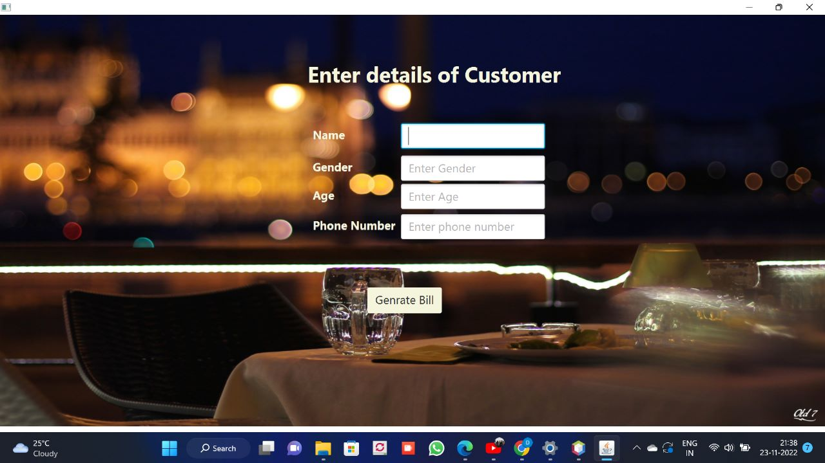
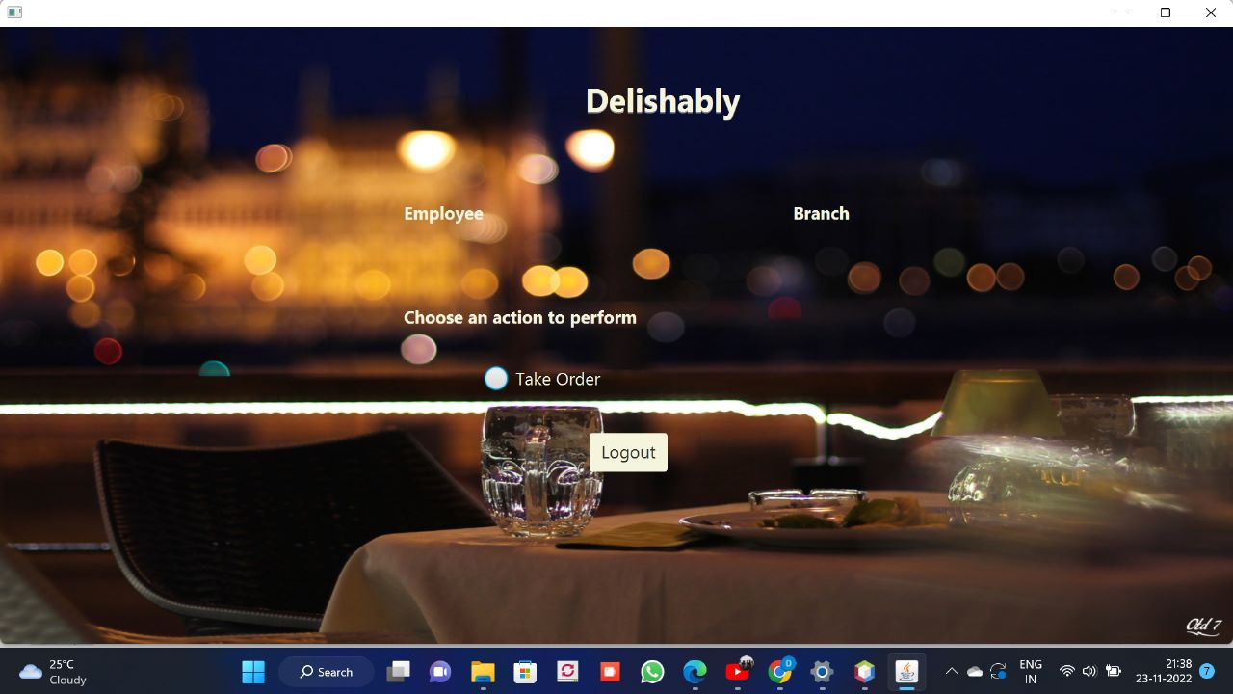
Customer Details and Bill

Slide 19
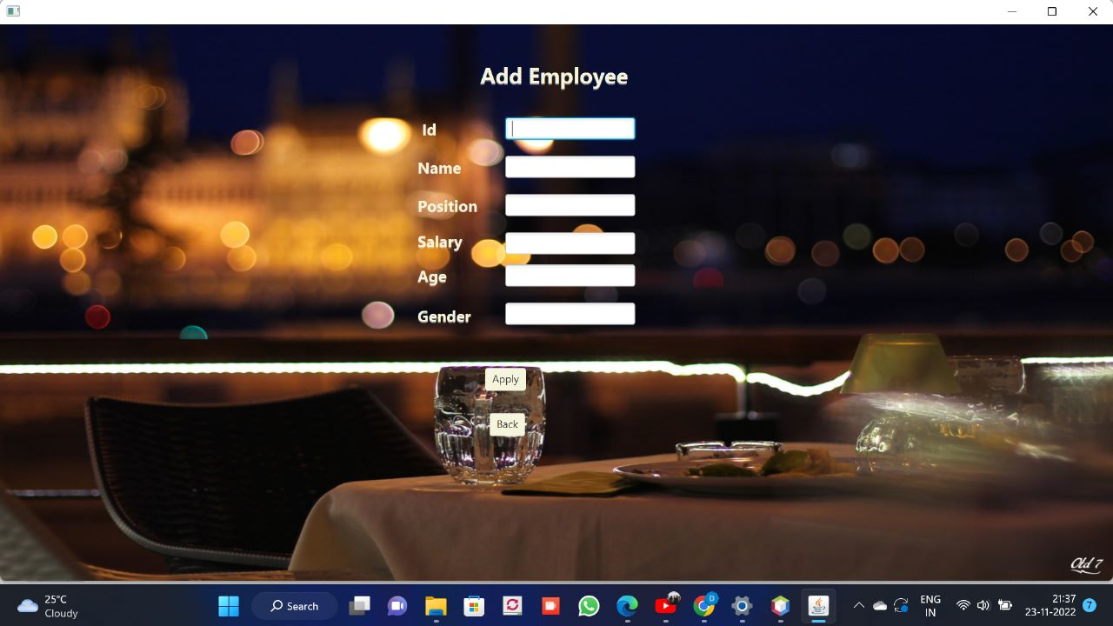
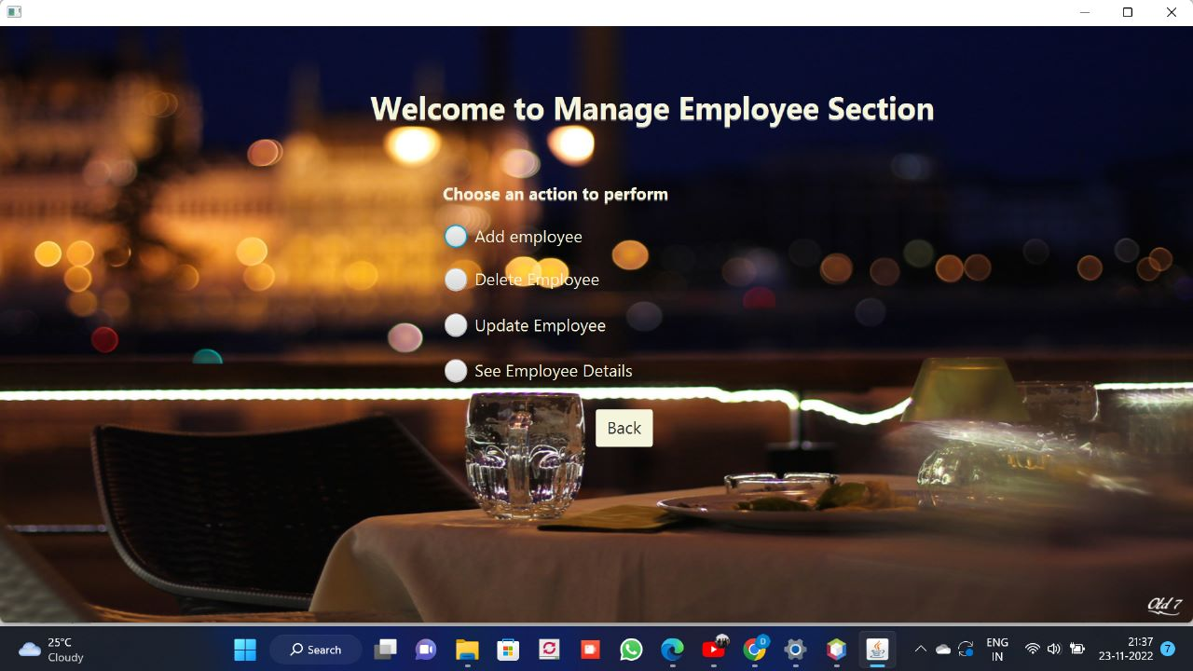
Manager and manage Employee Functions

Slide 20
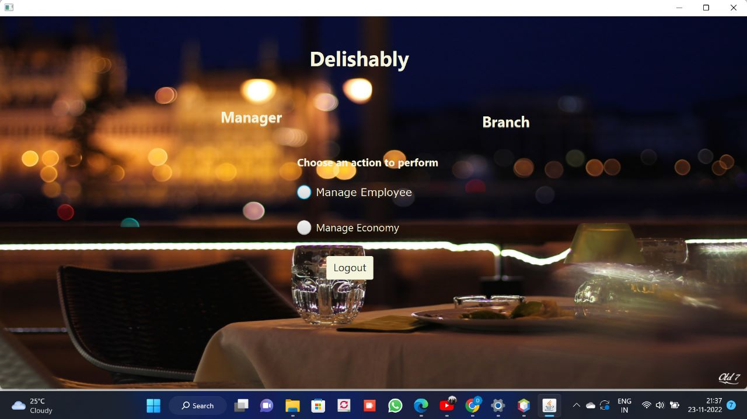
Manager View Economy Screens

Slide 21
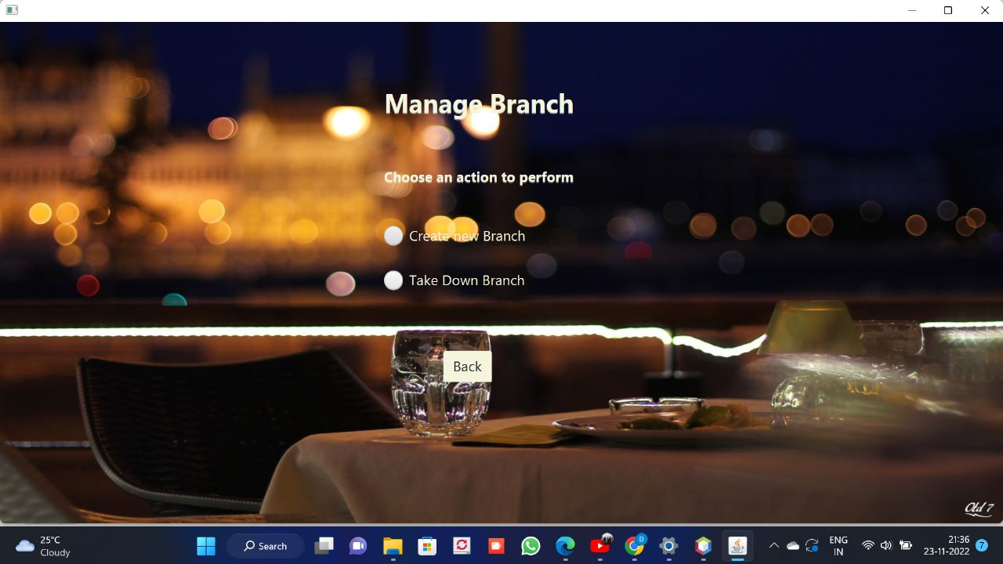
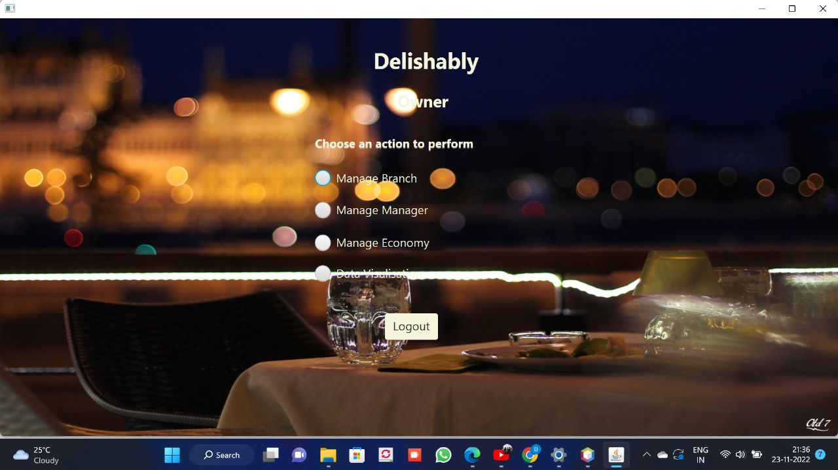
Owner and manage Branch Functions

Slide 22
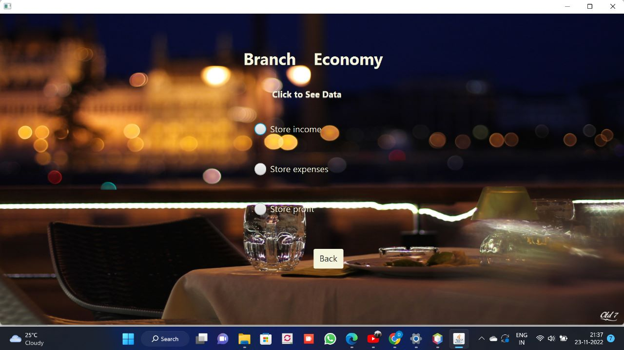
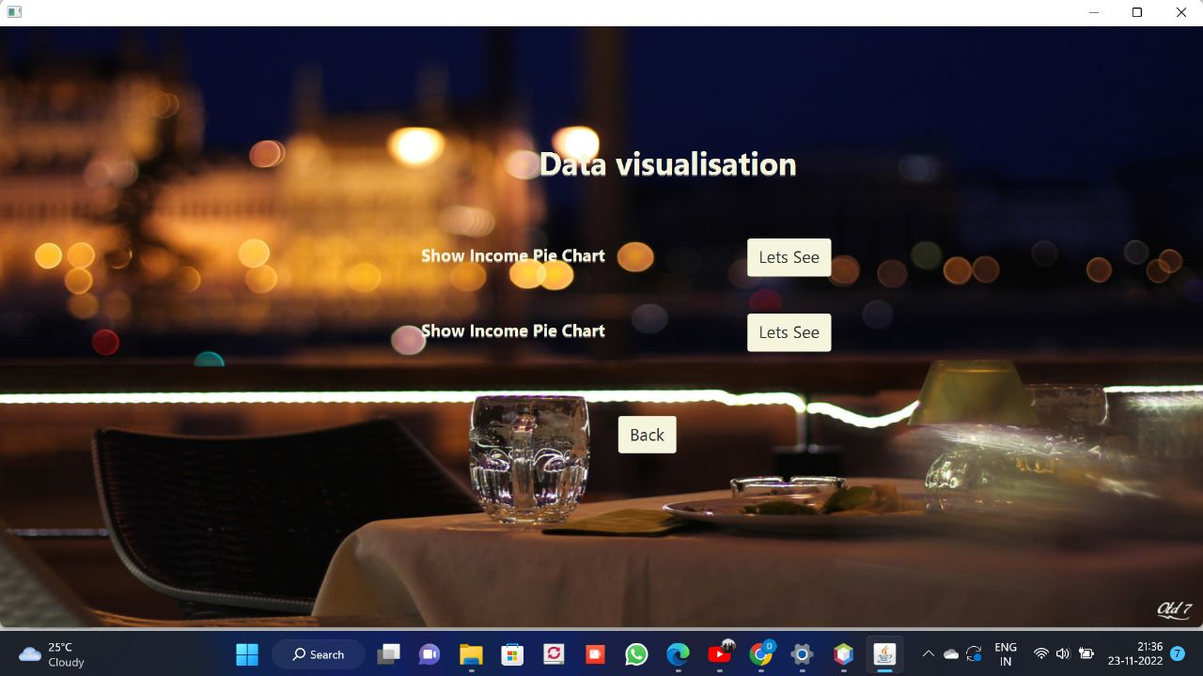
Manage Economy Functions

Slide 23
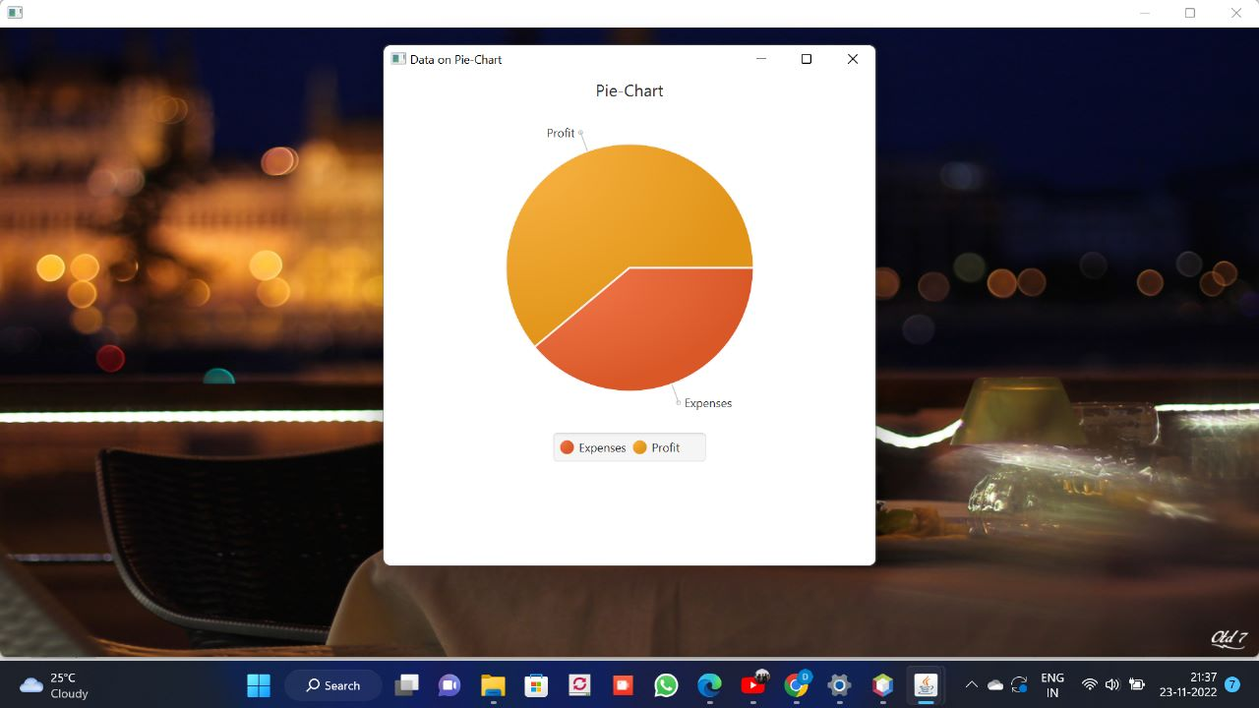

Owner Data Visualization

Slide 24
Thanks!

